Slide 1
Boundary Detection

Slide 2
Introduction
Boundary Detection is a powerful visual cue for recognizing objects in images, segmenting images into regions corresponding to individual objects, and, more generally, understanding the 3D structures of scenes.
However, to be able to exploit shape information, we need reliable ways of detecting fragments of object boundaries, a difficult problem in itself.
Boundary detection as a sub-process contributes to many fields like defence, health care, human-computer interaction, image retrieval and data mining, industrial and personal robotics, manufacturing, scientific image analysis, surveillance and security, and transportation.

Slide 3
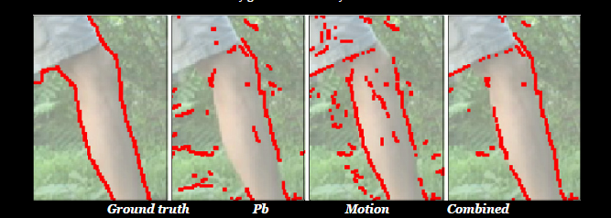
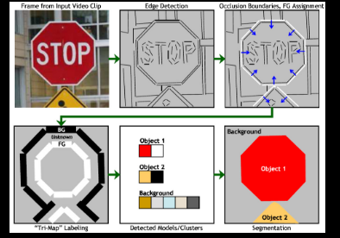
One such application which is being illustrated is that of looking for intrusion through CCTV footage.
Typical modern applications :
Estimating boundaries in motion pictures/videos
Construction of appearance models
Notes:
Martin's Pb detector

Slide 4
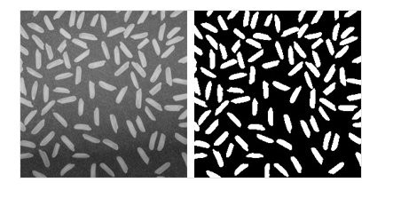
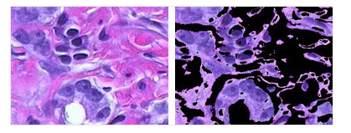
Types of boundary detection methods
Thresholding methods
Color-based and attribute selection methods

Slide 5
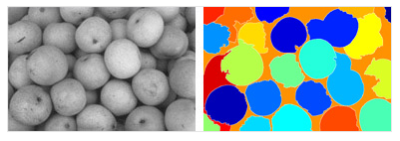
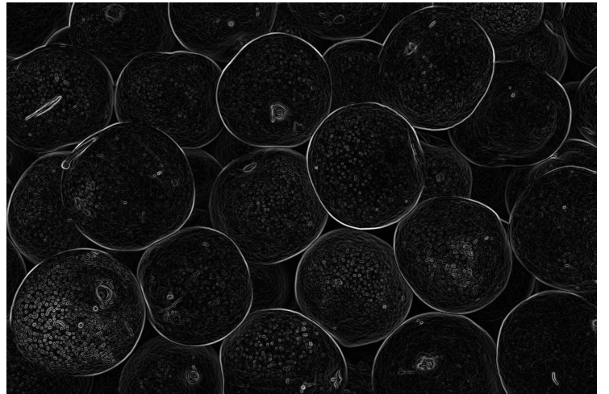
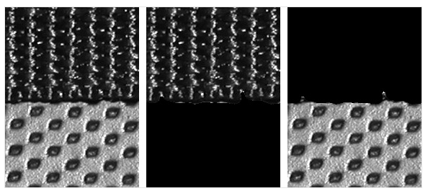
Transform methods
Texture methods
Notes:
Watershed segmentation
Texture- entropy randomness

Slide 6
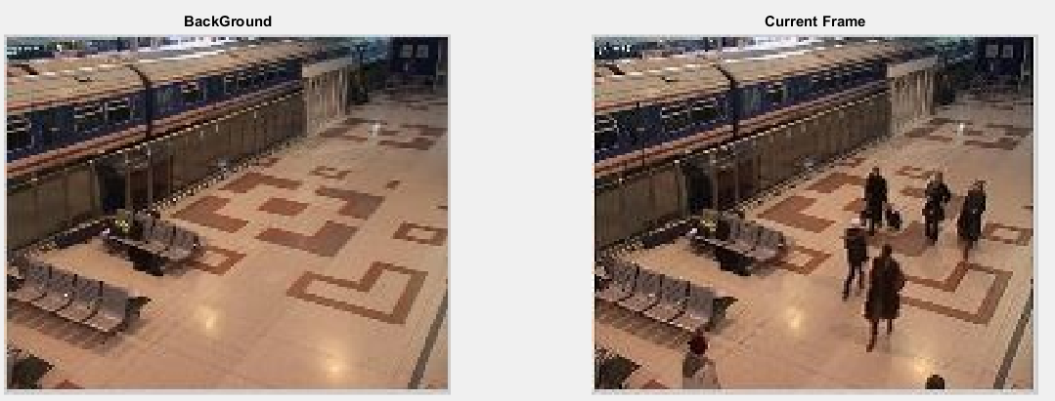
Flow
Read the images
Background=imread('background.jpg');
CurrentFrame=imread('original.jpg');

Slide 7
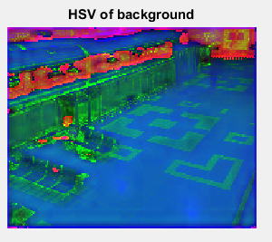
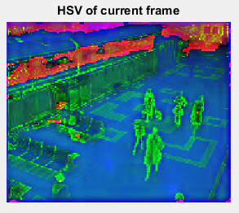
Convert both to HSV
[Background_hsv]=rgb2hsv(Background);
[CurrentFrame_hsv]=rgb2hsv(CurrentFrame);

Slide 8
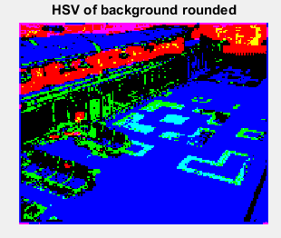
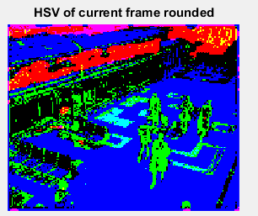
Round off both converted HSVs
[Background_hsv]=round(Background_hsv);
[CurrentFrame_hsv]=round(CurrentFrame_hsv);

Slide 9
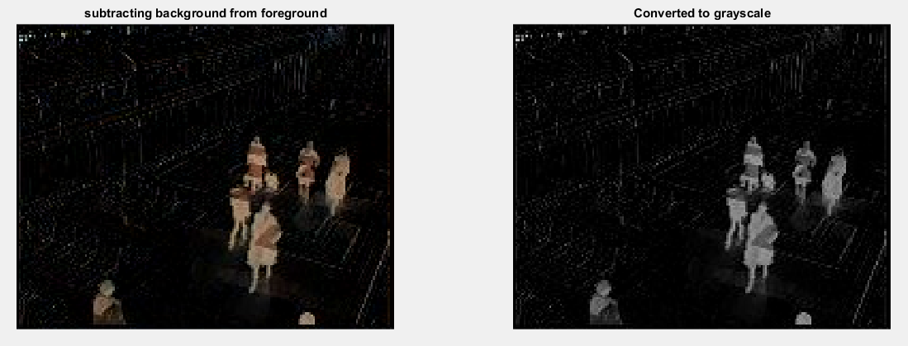
Subtracting background from current frame
And converting it to grayscale
ni=round(Background)-round(CurrentFrame);
%converting rounded RGB to grayscale
ni=rgb2gray(ni);

Slide 10
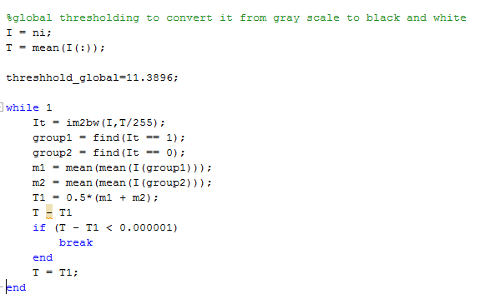
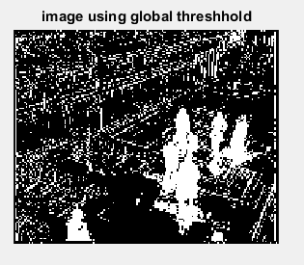
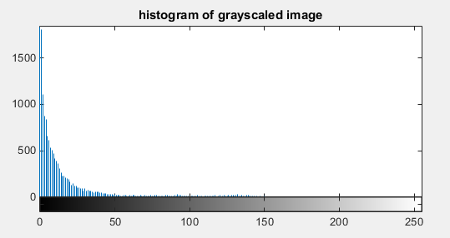
Thresholding to get binary image: Global Threshold

Slide 11
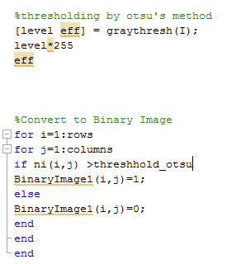
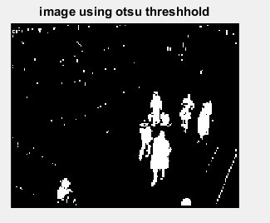
Thresholding to get binary image: Otsu’s Threshold

Slide 12
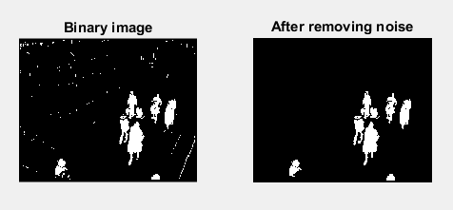
Noise Removal
When we say noise here, we mean to say other small elements which should not take into consideration.

Slide 13
Noise Removal
Function: out
out_bw=bwareaopen(in_bw,P)
in_bw :- input binary image
out_bwq:- output binary image
P:- threshold number of pixels
Out_bw=bwareaopne(in_bw,P,conn)
Conn:- connected components

Slide 14
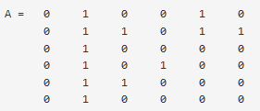
Noise Removal
Connected components can be 4 or 8
For example for image A
Considering the point A[4,4] it is 8 connected but not 4 connected
This will result in removal of that point from the image

Slide 15
Counting Objects
Once Noise is removed, its easier to count the number of objects present in the binary image
bwconncomp uses a flood fill algorithm do so
The basic steps in finding the connected components are:
Search for the next unlabeled pixel, p.
Use a flood-fill algorithm to label all the pixels in the connected component containing p.
Repeat steps 1 and 2 until all the pixels are labelled.

Slide 16
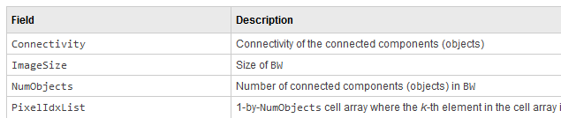
Connected Components
Function:
CC = bwconncomp( BW, conn)
BW is a binary image
Conn is the number of connected components need to be used
Function returns a structure with 4 members

Slide 17
Edge Detection
Edge detection is used for image segmentation and data extraction in areas such as image processing, computer vision, and machine vision.
Function:
i=edge(BW, method type, threshold,direction,thinning)
BW is a binary image
Method type is the approximation used for the edge detection (by default is ‘sobel’)
Threshold and Direction are optional parameters.
Threshold means the minimum intensity after which the edge needs to be detected.
Direction in which the function looks for edges in the image: 'horizontal', 'vertical', or 'both'.

Slide 18
Edge Detection
Common edge detection algorithms include Sobel, Canny, Prewitt.
Sobel’s method is used for the edge detection here
Sobel’s Method
edge.m in matlab toolbox uses sobel’s method.
It returns edges at those points where the gradient of the considered image is maximum.
The horizontal and vertical gradient matrices whose dimensions are 3×3 is used

Slide 19


Edge Detection
Directional derivative estimate vector G was defined such as density difference distance to neighbour.
Horizontal and Vertical mask of sobel operator

Slide 20
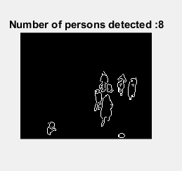
Application
Object Counting
Face Detection
Security
Manufacturing Industries

Slide 21
THANK YOU

